Slide 1
VEENESHWARI R S.D.N.B.V.C
V
VisionInspect AI
QUALITY INSPECTION SYSTEM
AI-Powered Industrial Defect Detection
Milestone 2
YOLO11n object detection trained on MVTec AD, served through a FastAPI backend, and surfaced in a full inspection dashboard with automated PDF reporting.
MVTec AD Dataset
Custom YOLO11n
FastAPI Backend
Live Dashboard
PDF Reports

Slide 2
STAGE 01 · DATA PREPARATION
Dataset Acquisition & Preparation
The MVTec Anomaly Detection (MVTec AD) dataset was downloaded and restructured into YOLO-compatible format, covering 15 industrial product categories used for defect classification.
15 Defect Categories (MVTec AD)
Tools & Scripts Used
Bottle
Cable
Capsule
prepare_mvtec_yolo.py Converts raw MVTec images/masks into YOLO label format
Carpet
Grid
Hazelnut
prepare_metal_nut_yolo.py Category-specific annotation preprocessing
Leather
Metal Nut
Pill
Screw
Tile
Toothbrush
reduce_mvtec.py Dataset subsampling for balanced class distribution
Transistor
Wood
Zipper
data.yaml YOLO dataset config — class names & train/val paths
02

Slide 3
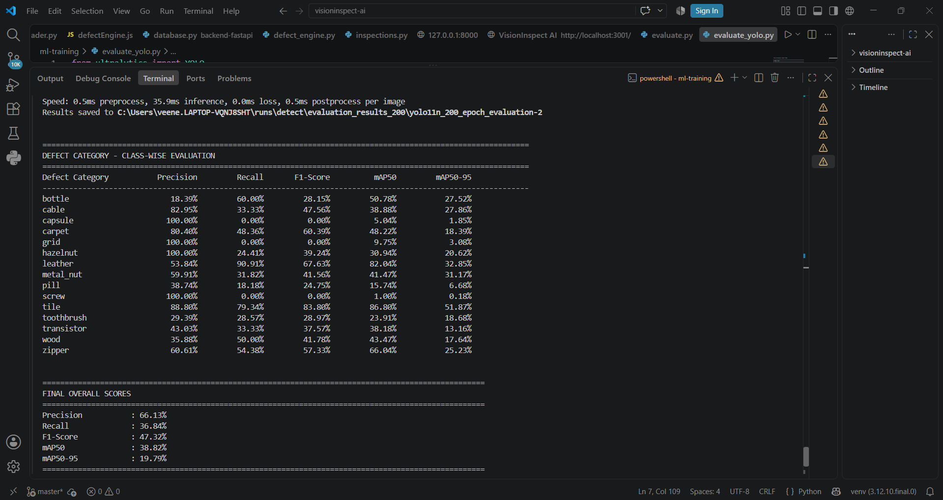
STAGE 02 · MODEL DEVELOPMENT
Model Training & Evaluation
YOLO was trained from scratch (no pretrained COCO weights) for a full 200 epochs on the prepared MVTec dataset, then evaluated class-by-class to confirm real, working defect detection across all 15 categories
Tools Used
Ultralytics YOLO
YOLO11n
PyTorch
Python
VS Code
Overall Evaluation Score
66.13% Precision
36.84% Recall
38.82% mAP50
03

Slide 4
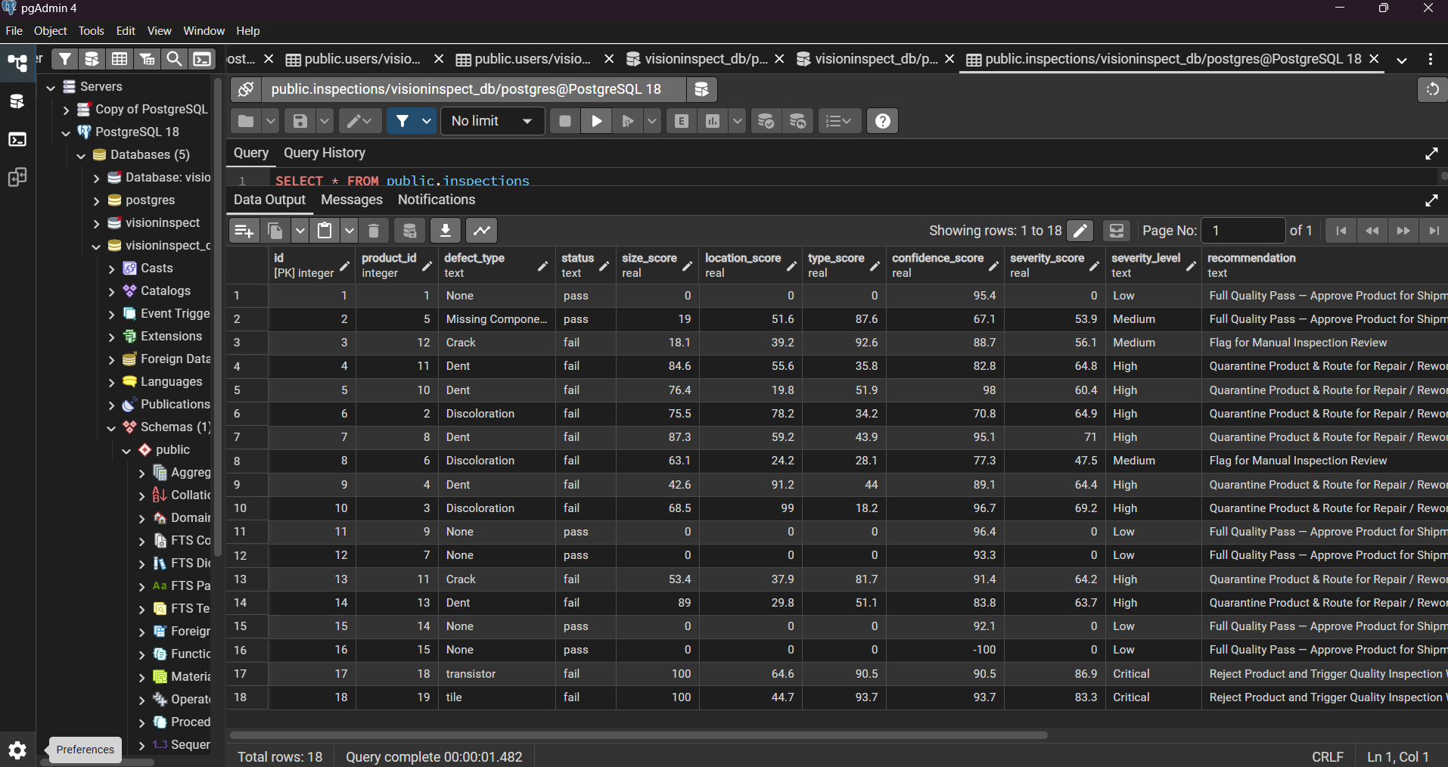
STAGE 03 · DATA LAYER & ARCHITECTURE
Database Design & Backend Integration
YOLO11n was trained from scratch (no pretrained COCO weights) for a full 200 epochs on the prepared MVTec dataset, then evaluated class-by-class to confirm real, working defect detection across all 15 categories
End-to-End Working Flow
1
React (Vite) Frontend User uploads product image
2
FastAPI Backend Receives image via REST endpoint
3
YOLO11n Model Runs inference on the trained checkpoint
4
PostgreSQL Database Stores defect type, severity & scores
5
Frontend Dashboard Displays result + generates PDF report
inspections table — built and populated via the FastAPI backend
04

Slide 5
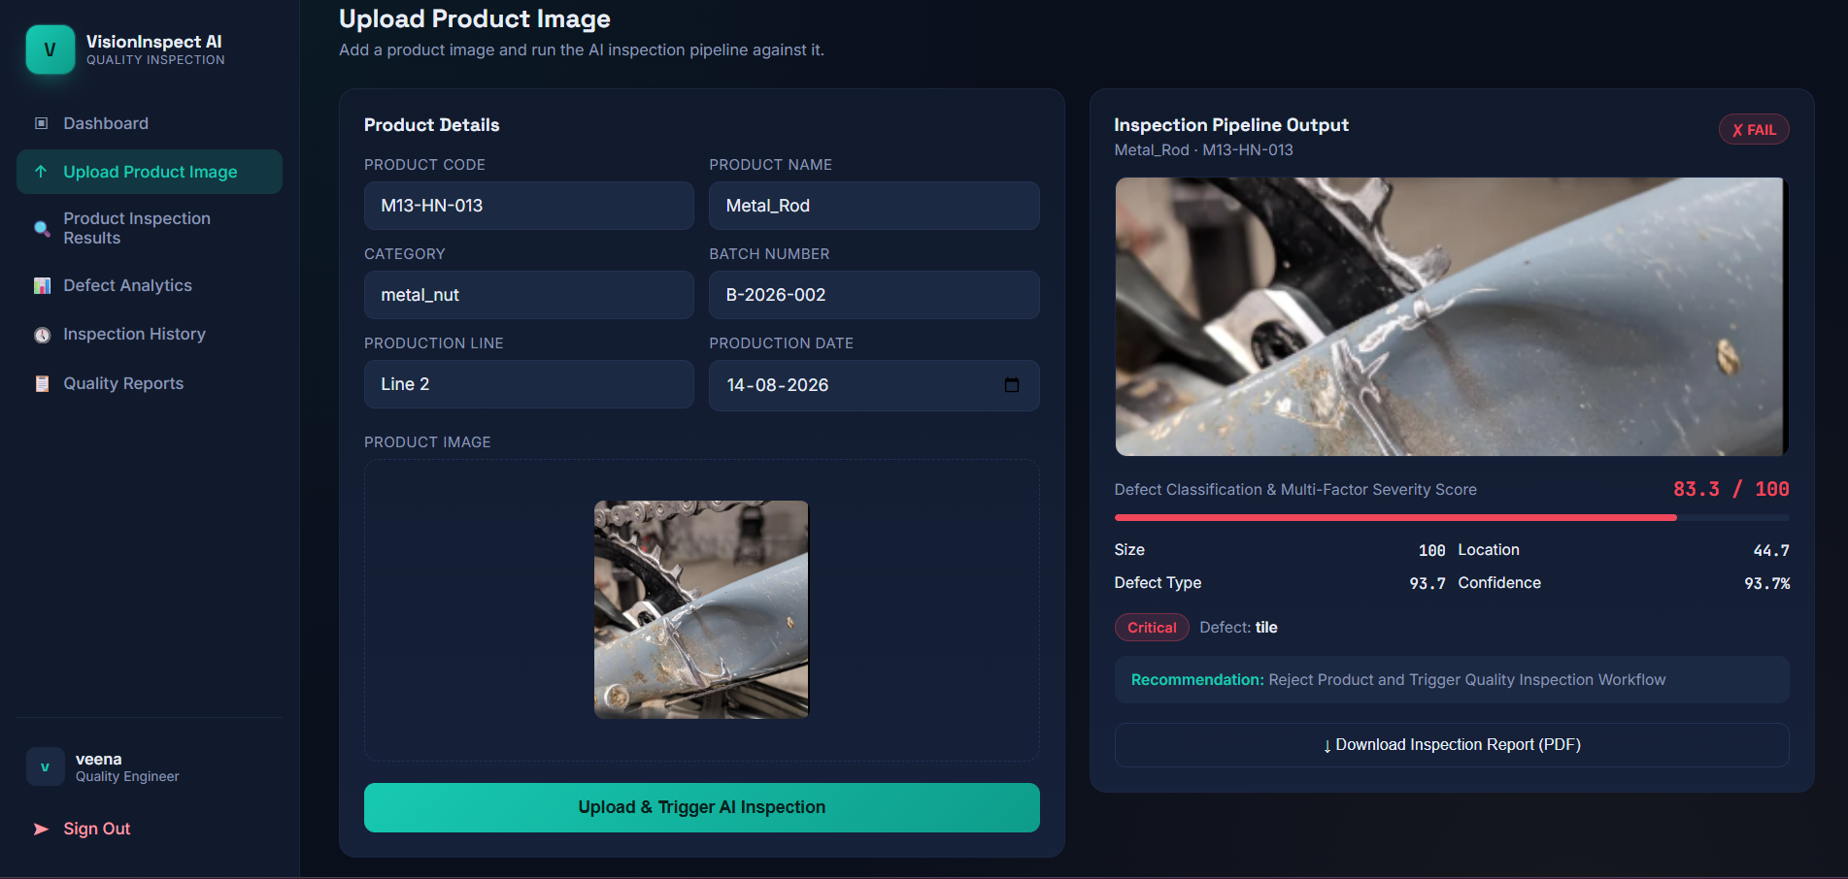
STAGE 04 · FRONTEND INTEGRATION
Product Upload & Live AI Inspection
The Vite/React frontend lets a quality engineer upload a product image and trigger the AI pipeline directly — returning defect type, severity, and recommendation in real time.
Tools Used
React
Vite
JWT Auth
FastAPI
Fetch API
05

Slide 6
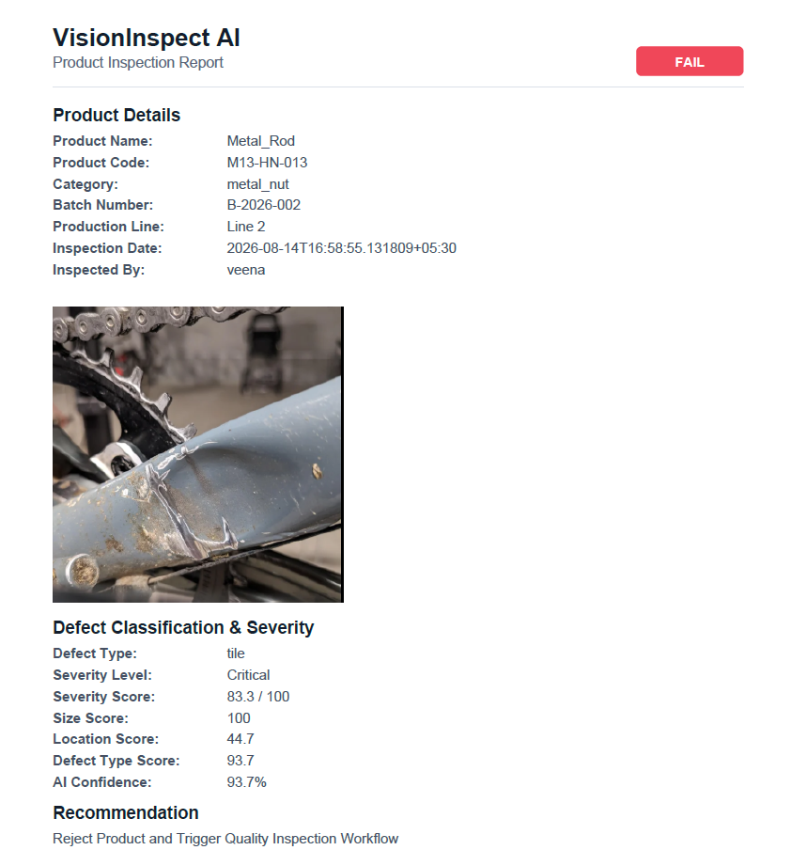
STAGE 05 · REPORTING
Automated Inspection Report (PDF)
Each completed inspection can be exported as a downloadable PDF report — capturing product details, the inspected image, defect classification and severity scoring.
Tools Used
jsPDF
React
FastAPI
PostgreSQL
Report Contents
Product details (name, code, batch, line)
Inspected product image
Defect type & severity level (Low → Critical)
Size, location, type & confidence scores
Actionable recommendation for the line
06

Slide 7
MILESTONE 2 SUMMARY
End-to-End VisionInspect AI Workflow
Upload Image
→
Backend API
→
YOLO Model
→
Defect Detection
→
Results
→
Inspection Report
Built a complete YOLO-based industrial defect detection system on the MVTec AD dataset, from raw data to a working product
Trained a custom YOLO11n model from scratch, evaluated with standard object-detection metrics (Precision, Recall, mAP@50, mAP@50-95)
Delivered a FastAPI backend with authenticated inspection APIs, verified via Swagger, and fully connected to the frontend dashboard
Shipped an end-to-end experience: image upload → AI inspection → severity scoring → downloadable PDF report
07
VisionInspect AI

Slide 8
THANK YOU

